Slide 1

Motivation Concepts
© 2009 Prentice-Hall Inc. All rights reserved.
6-<number>

Slide 2
Chapter Learning Objectives
After studying this chapter, you should be able to:
  Describe the three elements of motivation.
  Identify four early theories of motivation and evaluate their applicability today.
  Apply the predictions of Cognitive Evaluation theory to intrinsic and extrinsic rewards.
  Compare and contrast goal-setting theory and Management by Objectives.
  Contrast reinforcement theory and goal-setting theory.
  Demonstrate how organizational justice is a refinement of equity theory.
  Apply the key tenets of expectancy theory to motivating employees.
  Compare contemporary theories of motivation.
  Explain to what degree motivation theories are culture-bound.
© 2009 Prentice-Hall Inc. All rights reserved.
6-<number>

Slide 3

Defining Motivation
The result of the interaction between the individual and the situation.
The processes that account for an individual’s intensity, direction, and persistence of effort toward attaining a goal – specifically, an organizational goal.
Three key elements:
  Intensity – how hard a person tries
  Direction – effort that is channeled toward, and consistent with, organizational goals
  Persistence – how long a person can maintain effort
© 2009 Prentice-Hall Inc. All rights reserved.
6-<number>

Slide 4

Early Theories of Motivation
These early theories may not be valid, but they do form the basis for contemporary theories and are still used by practicing managers.
Maslow’s Hierarchy of Needs Theory
  Alderfer’s ERG (Existence, Relatedness, and Growth)
McGregor’s Theory X and Theory Y
Herzberg’s Two-Factor Theory
McClelland’s Theory of Needs
© 2009 Prentice-Hall Inc. All rights reserved.
6-<number>

Slide 5
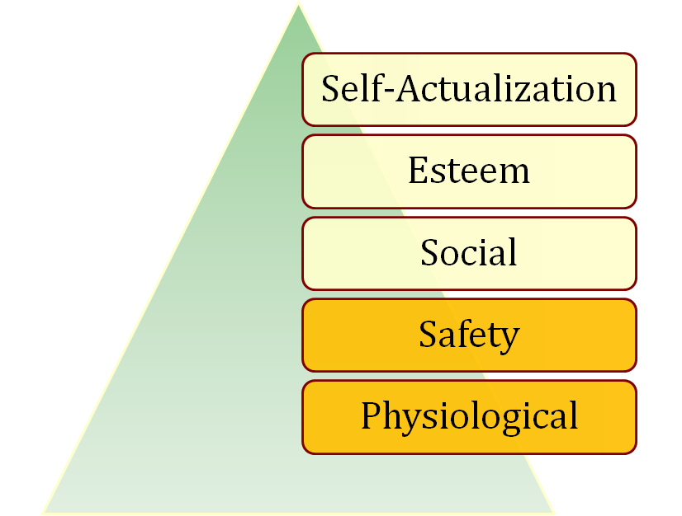
Maslow’s Hierarchy of Needs
There is a hierarchy of five needs. As each need is substantially satisfied, the next need becomes dominant.
Assumptions
  Individuals cannot move to the next higher level until all needs at the current (lower) level are satisfied
  Must move in hierarchical order
Higher Order
Internal
Lower Order
External
See E X H I B I T 6-1
© 2009 Prentice-Hall Inc. All rights reserved.
6-<number>

Slide 6
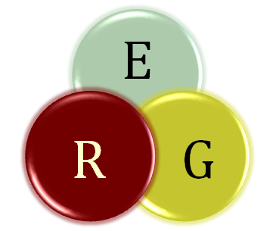
Alderfer’s ERG Theory
A reworking of Maslow to fit empirical research.
Three groups of core needs:
  Existence (Maslow: physiological and safety)
  Relatedness (Maslow: social and status)
  Growth (Maslow: esteem and self-actualization)
Removed the hierarchical assumption
  Can be motivated by all three at once
Popular, but not accurate, theory
© 2009 Prentice-Hall Inc. All rights reserved.
6-<number>

Slide 7
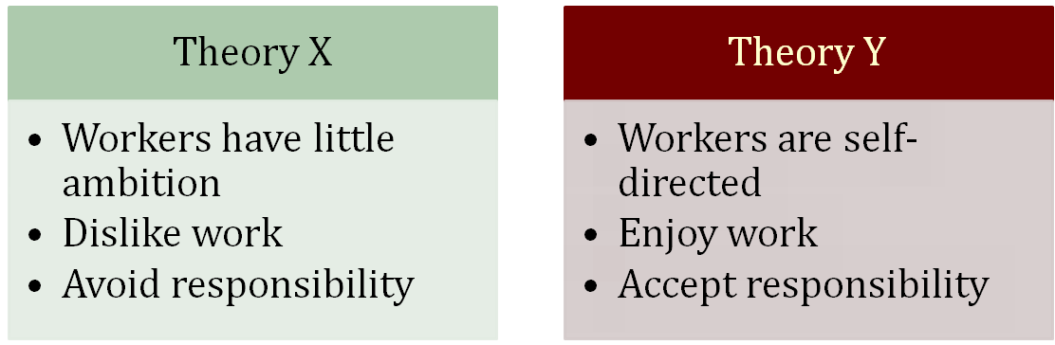
McGregor’s Theory X and Theory Y
Two distinct views of human beings: Theory X (basically negative) and Theory Y (positive).
  Managers used a set of assumptions based on their view
  The assumptions molded their behavior toward employees
No empirical evidence to support this theory.
© 2009 Prentice-Hall Inc. All rights reserved.
6-<number>

Slide 8
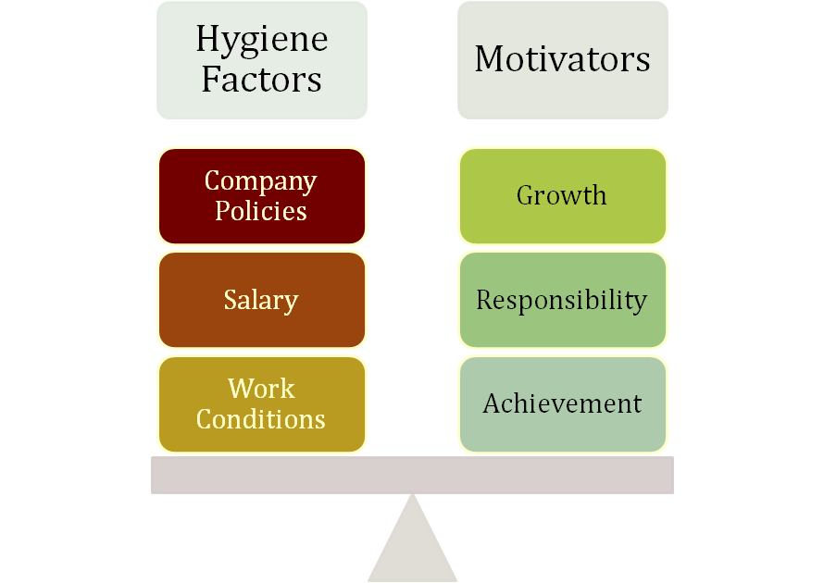
Herzberg’s Two-Factor Theory
Key Point: Satisfaction and dissatisfaction are not opposites but separate constructs
Extrinsic and Related to Dissatisfaction
Intrinsic and Related to Satisfaction
See E X H I B I T S 6-2 and 6-3
© 2009 Prentice-Hall Inc. All rights reserved.
6-<number>

Slide 9

Criticisms of Two-Factor Theory
Herzberg says that hygiene factors must be met to remove dissatisfaction. If motivators are given, then satisfaction can occur.
Herzberg is limited by his procedure
  Participants had self-serving bias
Reliability of raters questioned
  Bias or errors of observation
No overall measure of satisfaction was used
Herzberg assumed, but didn’t research, a strong relationship between satisfaction and productivity
© 2009 Prentice-Hall Inc. All rights reserved.
6-<number>

Slide 10
McClelland’s Three Needs Theory
Need for Achievement (nAch)
  The drive to excel, to achieve in relation to a set of standards, to strive to succeed
Need for Power (nPow)
  The need to make others behave in a way that they would not have behaved otherwise
Need for Affiliation (nAff)
  The desire for friendly and close interpersonal relationships
People have varying levels of each of the three needs.
  Hard to measure
© 2009 Prentice-Hall Inc. All rights reserved.
6-<number>

Slide 11
Performance Predictions for High nAch
People with a high need for achievement are likely to:
  Prefer to undertake activities with a 50/50 chance of success, avoiding very low- or high-risk situations
  Be motivated in jobs that offer high degree of personal responsibility, feedback, and moderate risk
  Not necessarily make good managers – too personal a focus. Most good general managers do NOT have a high nAch
  Need high level of nPow and low nAff for managerial success
Good research support, but it is not a very practical theory
© 2009 Prentice-Hall Inc. All rights reserved.
6-<number>

Slide 12

Contemporary Theories of Motivation
Cognitive Evaluation Theory
Goal-Setting Theory
  Management by Objectives (MBO)
Self-Efficacy Theory
  Also known as Social Cognitive Theory or Social Learning Theory
Reinforcement Theory
Equity Theory
Expectancy Theory
© 2009 Prentice-Hall Inc. All rights reserved.
6-<number>

Slide 13
Cognitive Evaluation Theory
Providing an extrinsic reward for behavior that had been previously only intrinsically rewarding tends to decrease the overall level of motivation
Major Implications for work rewards
  Intrinsic and extrinsic rewards are not independent
  Extrinsic rewards decrease intrinsic rewards
  Pay should be noncontingent on performance
  Verbal rewards increase intrinsic motivation; tangible rewards reduce it
Self-concordance
  When the personal reasons for pursuing goals are consistent with personal interests and core values (intrinsic motivation), people are happier and more successful
See E X H I B I T 6-4
© 2009 Prentice-Hall Inc. All rights reserved.
6-<number>

Slide 14
Locke’s Goal-Setting Theory
Basic Premise:
  That specific and difficult goals, with self-generated feedback, lead to higher performance
Difficult Goals:
  Focus and direct attention
  Energize the person to work harder
  Difficulty increases persistence
  Force people to be more effective and efficient
Relationship between goals and performance depends on:
  Goal commitment (the more public the better!)
  Task characteristics (simple, well-learned)
  Culture (best match is in North America)
© 2009 Prentice-Hall Inc. All rights reserved.
6-<number>

Slide 15

Implementation: Management by Objectives
MBO is a systematic way to utilize goal-setting.
Goals must be:
  Tangible
  Verifiable
  Measurable
Corporate goals are broken down into smaller, more specific goals at each level of organization.
Four common ingredients to MBO programs:
  Goal specificity
  Participative decision making
  Explicit time period
  Performance feedback
See E X H I B I T 6-5
© 2009 Prentice-Hall Inc. All rights reserved.
6-<number>

Slide 16
Bandura’s Self-Efficacy Theory
An individual’s belief that he or she is capable of performing a task.
  Higher efficacy is related to:
    Greater confidence
    Greater persistence in the face of difficulties
    Better response to negative feedback (work harder)
  Self-Efficacy complements Goal-Setting Theory.
Increased Confidence
Given Hard Goal
Higher Performance
Higher Self-Set Goal
See E X H I B I T 6-6
© 2009 Prentice-Hall Inc. All rights reserved.
6-<number>

Slide 17

Increasing Self-Efficacy
Enactive mastery
  Most important source of efficacy
  Gaining relevant experience with task or job
  “Practice makes perfect”
Vicarious modeling
  Increasing confidence by watching others perform the task
  Most effective when observer sees the model to be similar to him- or herself
Verbal persuasion
  Motivation through verbal conviction
  Pygmalion and Galatea effects - self-fulfilling prophecies
Arousal
  Getting “psyched up” – emotionally aroused – to complete task
  Can hurt performance if emotion is not a component of the task
© 2009 Prentice-Hall Inc. All rights reserved.
6-<number>

Slide 18

Reinforcement Theory
Similar to Goal-Setting Theory, but focused on a behavioral approach rather than a cognitive one.
  Behavior is environmentally caused
  Thought (internal cogitative event) is not important
    Feelings, attitudes, and expectations are ignored
  Behavior is controlled by its consequences – reinforcers
  Is not a motivational theory but a means of analysis of behavior
  Reinforcement strongly influences behavior but is not likely to be the sole cause
© 2009 Prentice-Hall Inc. All rights reserved.
6-<number>

Slide 19

Adams’ Equity Theory
Employees compare their ratios of outcomes-to-inputs of relevant others.
  When ratios are equal: state of equity exists – there is no tension as the situation is considered fair
  When ratios are unequal: tension exists due to unfairness
    Underrewarded states cause anger
    Overrewarded states cause guilt
  Tension motivates people to act to bring their situation into equity
See E X H I B I T 6-7
© 2009 Prentice-Hall Inc. All rights reserved.
6-<number>

Slide 20

Equity Theory’s “Relevant Others”
Can be four different situations:
  Self-Inside
    The person’s experience in a different job in the same organization
  Self-Outside
    The person’s experience in a different job in a different organization
  Other-Inside
    Another individual or group within the organization
  Other-Outside
    Another individual or group outside of the organization
© 2009 Prentice-Hall Inc. All rights reserved.
6-<number>

Slide 21

Reactions to Inequity
Employee behaviors to create equity:
  Change inputs (slack off)
  Change outcomes (increase output)
  Distort/change perceptions of self
  Distort/change perceptions of others
  Choose a different referent person
  Leave the field (quit the job)
Propositions relating to inequitable pay:
  Paid by time:
    Overrewarded employees produce more
    Underrewarded employees produce less with low quality
  Paid by quality:
    Overrewarded employees give higher quality
    Underrewarded employees make more of low quality
© 2009 Prentice-Hall Inc. All rights reserved.
6-<number>

Slide 22
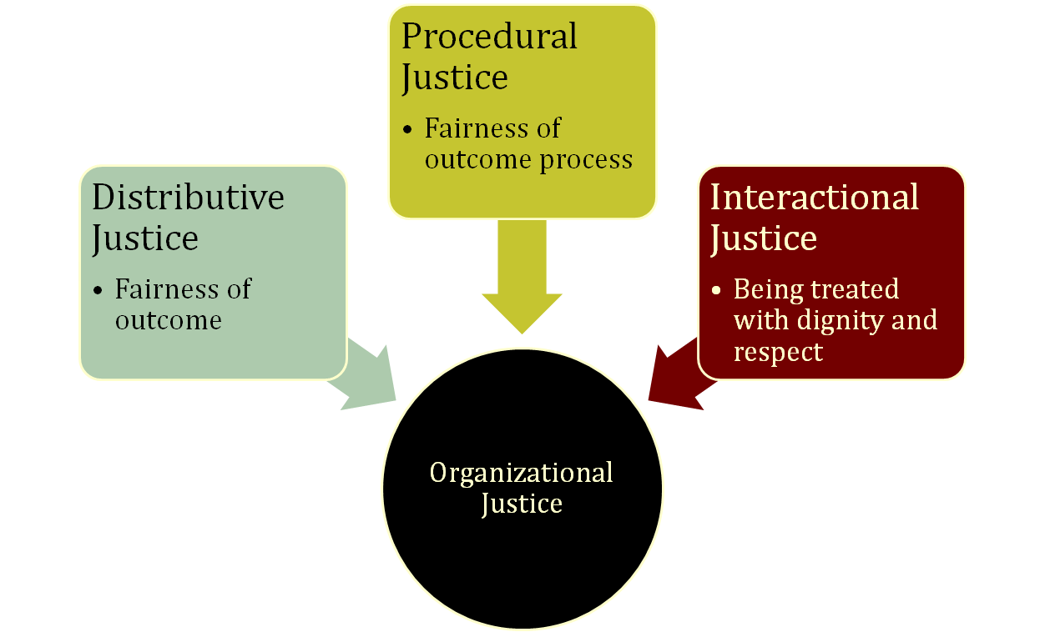
Justice and Equity Theory
Overall perception of what is fair in the workplace.
See E X H I B I T 6-8
© 2009 Prentice-Hall Inc. All rights reserved.
6-<number>

Slide 23
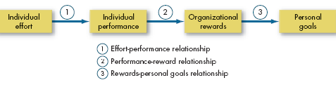
Vroom’s Expectancy Theory
The strength of a tendency to act in a certain way depends on the strength of an expectation that the act will be followed by a given outcome and on the attractiveness of the outcome to the individual.
Expectancy of performance success
Instrumentality of success in getting reward
Valuation of the reward in employee’s eyes
See E X H I B I T 6-9
© 2009 Prentice-Hall Inc. All rights reserved.
6-<number>

Slide 24
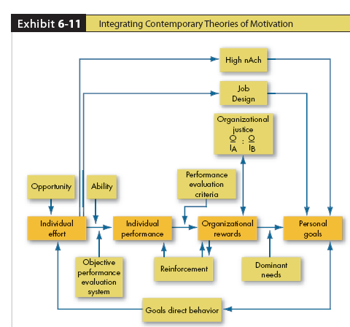
Integrating Contemporary Motivation Theories
Based on Expectancy Theory
See E X H I B I T 6-10
© 2009 Prentice-Hall Inc. All rights reserved.
6-<number>

Slide 25

Global Implications
Motivation theories are often culture-bound.
  Maslow’s Hierarchy of Needs Theory
    Order of needs is not universal
  McClelland’s Three Needs Theory
    nAch presupposes a willingness to accept risk and performance concerns – not universal traits
  Adams’ Equity Theory
    A desire for equity is not universal
    “Each according to his need” – socialist/former communists
Desire for interesting work seems to be universal.
  There is some evidence that the intrinsic factors of Herzberg’s Two-Factor Theory may be universal
© 2009 Prentice-Hall Inc. All rights reserved.
6-<number>

Slide 26
Summary and Managerial Implications
Need Theories (Maslow, Alderfer, McClelland, Herzberg)
  Well known, but not very good predictors of behavior
Goal-Setting Theory
  While limited in scope, good predictor
Reinforcement Theory
  Powerful predictor in many work areas
Equity Theory
  Best known for research in organizational justice
Expectancy Theory
  Good predictor of performance variables but shares many of the assumptions as rational decision making
© 2009 Prentice-Hall Inc. All rights reserved.
6-<number>

Slide 27

All rights reserved. No part of this publication may be reproduced, stored in a retrieval system, or transmitted, in any form or by any means, electronic, mechanical, photocopying, recording, or otherwise, without the prior written permission of the publisher. Printed in the United States of America.
Copyright ©2009 Pearson Education, Inc. Publishing as Prentice Hall

